Slide 1
Chapter 10: Programmable Logic

Slide 2
Chapter Objectives
After studying this chapter, students should be able to:
Learn about types of programmable logic (SPLDs, CPLDs, FPGAs) and distinguish their basic structures.
Describe the architecture and operation of components such as PAL, GAL, PLA, macrocells, and LUTs.
Understand the concepts of intellectual property and platform FPGA, along with embedded functions in design.
Present the software design flow for programmable devices: design entry, simulation, synthesis, implementation, and downloading.
Discuss various testing methods for programmable logic devices, including boundary scan logic.

Slide 3
Chapter Outline
10.1. Simple Programmable Logic Devices (SPLDs) 10.2. Complex Programmable Logic Devices (CPLDs) 10.3. Macrocell Modes 10.4. Field-Programmable Gate Arrays (FPGAs) 10.5. Programmable Logic Software 10.6. Boundary Scan Logic
Multiple-choice test and Problems

Slide 4
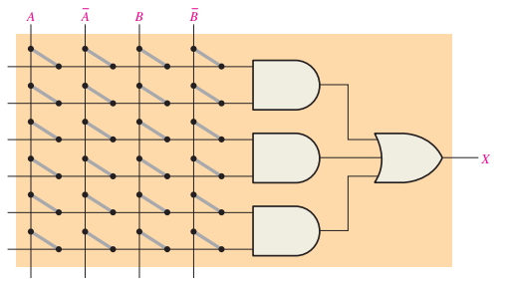

10.1. Simple Programmable Logic Devices (SPLDs)
SPLD: The PAL
A PAL consists of a programmable array of AND gates connected to a fixed array of OR gates.
Typically implemented using fuse technology → One-Time Programmable (OTP).

Slide 5

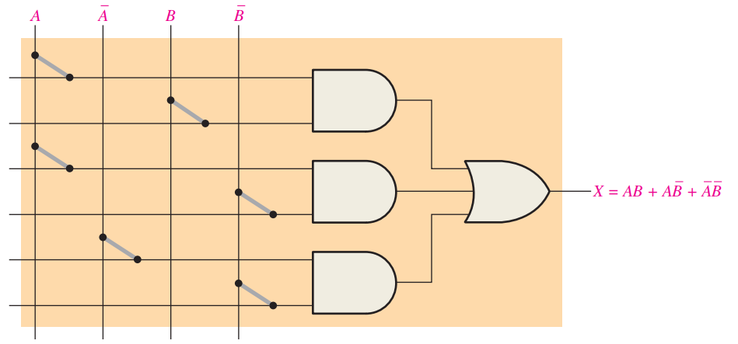
10.1. Simple Programmable Logic Devices (SPLDs)
Implementing a Sum-of-Products Expression Use a PAL to implement the SOP expression:

Slide 6
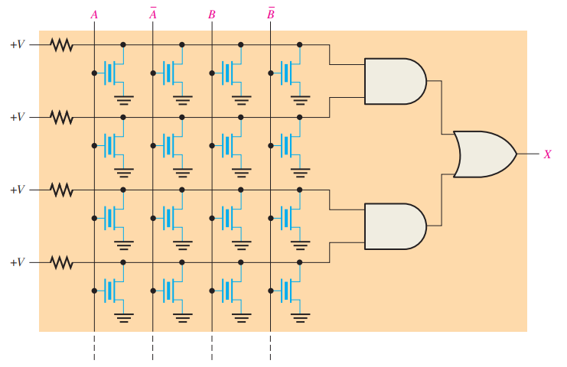

10.1. Simple Programmable Logic Devices (SPLDs)
SPLD: The GAL GAL is a reprogrammable version of PAL.
Uses the same AND/OR logic structure as PAL.

Slide 7
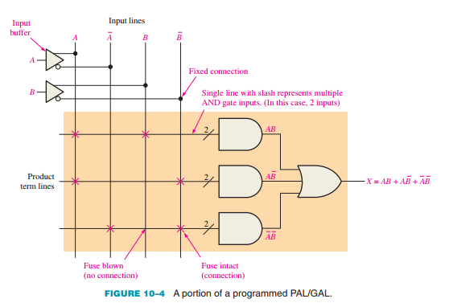
10.1. Simple Programmable Logic Devices (SPLDs)
Simplified Notation for PAL/GAL Diagrams

Slide 8
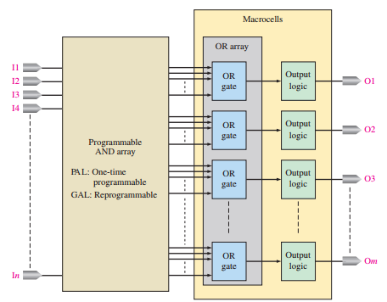
10.1. Simple Programmable Logic Devices (SPLDs)
PAL/GAL General Block Diagram

Slide 9
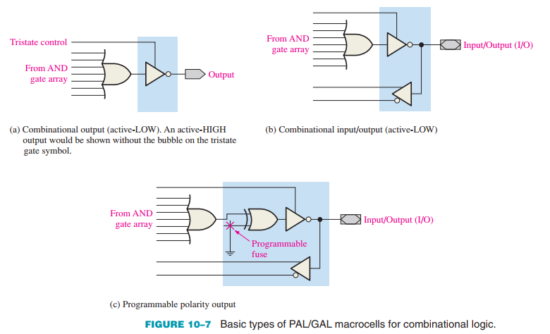
10.1. Simple Programmable Logic Devices (SPLDs)
Macrocells

Slide 10
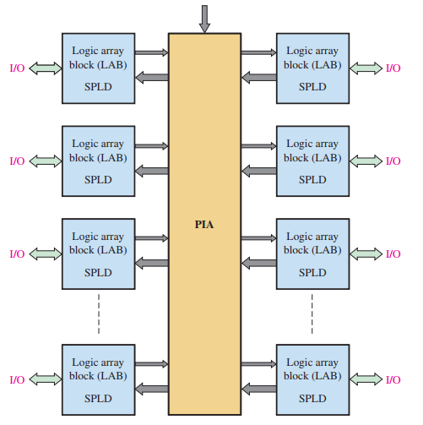
10.2. Complex Programmable Logic Devices (CPLDs)
The CPLD CPLD (Complex Programmable Logic Device) is made up of multiple SPLDs connected through programmable interconnections. The internal structure may vary depending on the manufacturer.
FIGURE 10–8 Basic block diagram of a generic CPLD

Slide 11
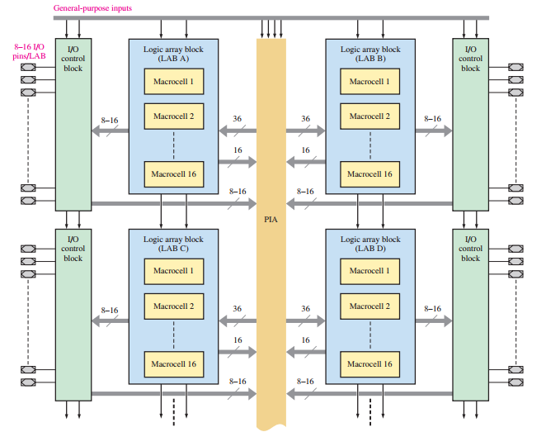
10.2. Complex Programmable Logic Devices (CPLDs)
Classic CPLD Architecture

Slide 12
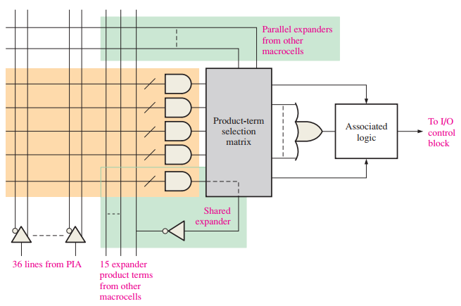
10.2. Complex Programmable Logic Devices (CPLDs)
Simplified diagram of a macrocell in a typical CPLD

Slide 13
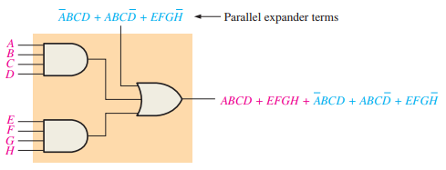
10.2. Complex Programmable Logic Devices (CPLDs)
Parallel Expanders Used to increase the number of product terms available to a macrocell.
Example: A macrocell with 2 product terms borrows 3 additional terms via a parallel expander.

Slide 14
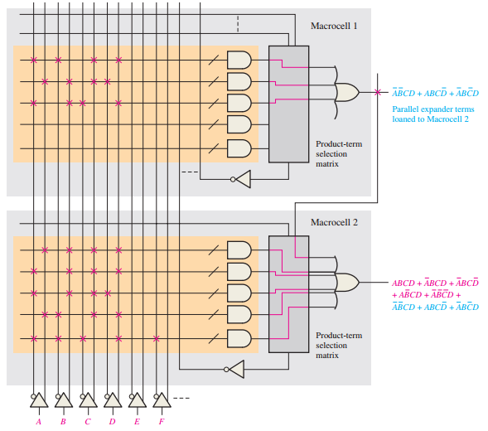
10.2. Complex Programmable Logic Devices (CPLDs)
LUT CPLD Architecture Uses Logic Elements (LEs) inside logic array blocks (LABs), similar to FPGAs. Interconnections are arranged in a row/column structure between LABs. Inputs/outputs (IOEs) are around the edges.

Slide 15
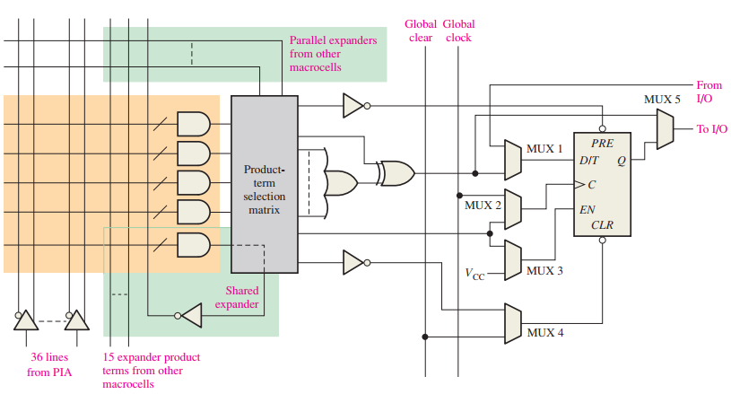
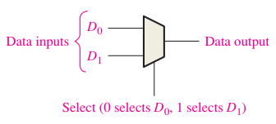

10.3. Macrocell Modes
Multiplexer (MUX)
FIGURE 10–19 Commonly used symbol for a multiplexer. It can have any number of inputs.

Slide 16
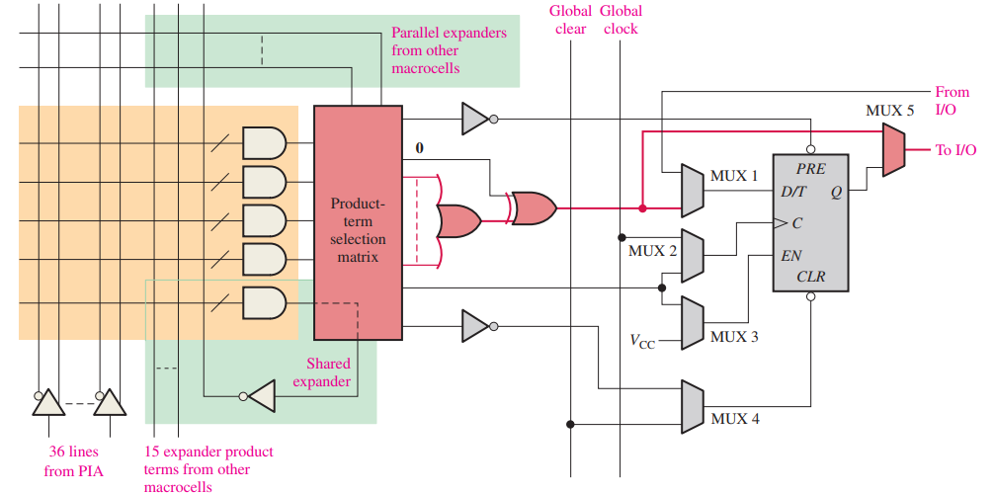
10.3. Macrocell Modes
The Combinational Mode

Slide 17
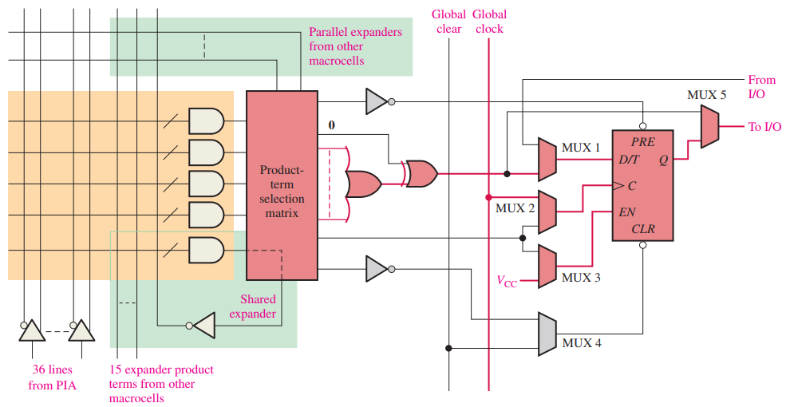

10.3. Macrocell Modes
The Registered Mode

Slide 18
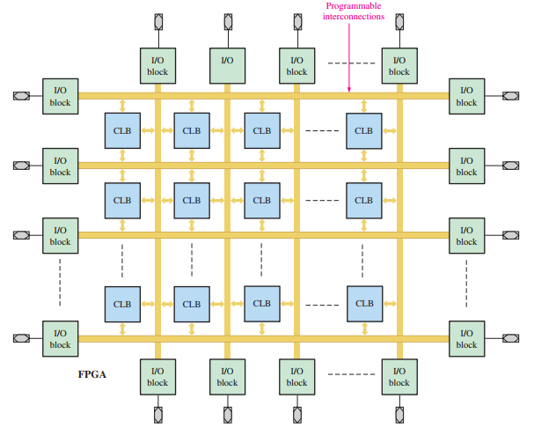
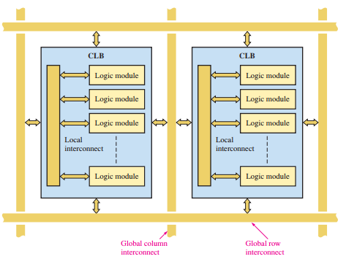
10.4. Field-Programmable Gate Arrays (FPGAs)
Configurable Logic Blocks
Basic structure of an FPGA. CLB is configurable logic block, also known as logic array block (LAB)

Slide 19
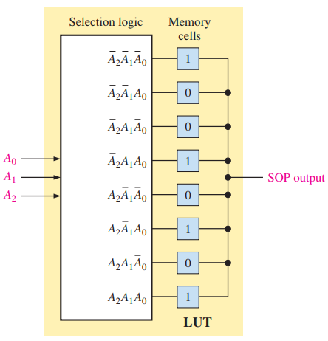

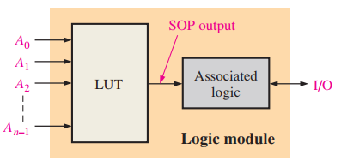
10.4. Field-Programmable Gate Arrays (FPGAs)
Logic Modules

Slide 20
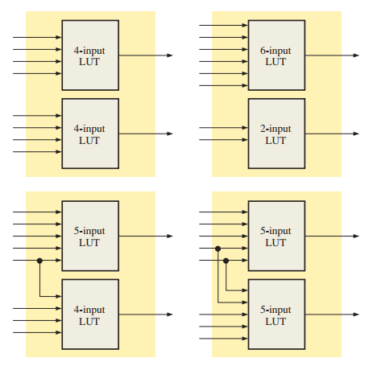
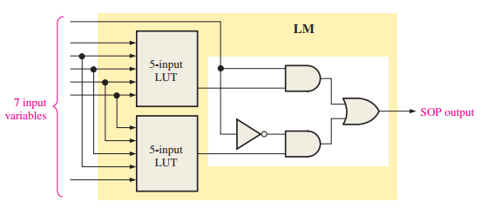

10.4. Field-Programmable Gate Arrays (FPGAs)
Operating Modes of a Logic Module

Slide 21
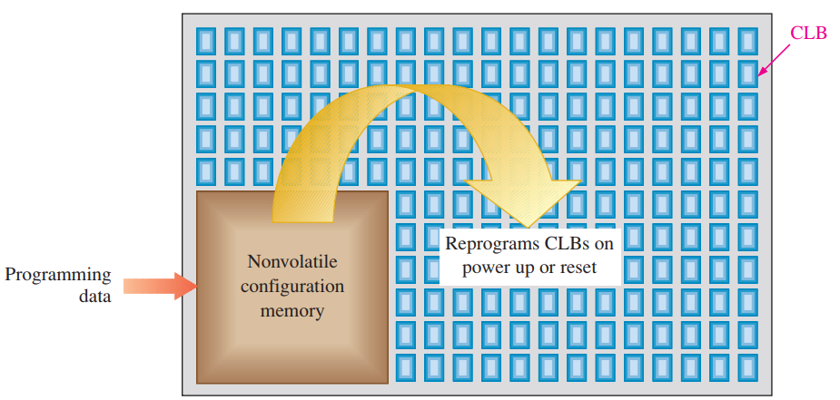
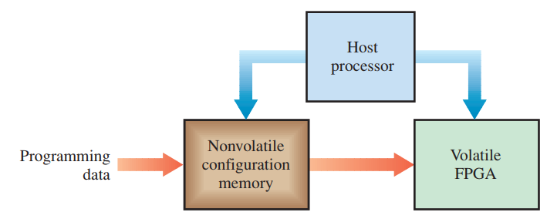
10.4. Field-Programmable Gate Arrays (FPGAs)
SRAM-Based FPGAs
(a) Volatile FPGA with on-the-chip nonvolatile configuration memory
(b) Volatile FPGA with on-board memory and host processor

Slide 22
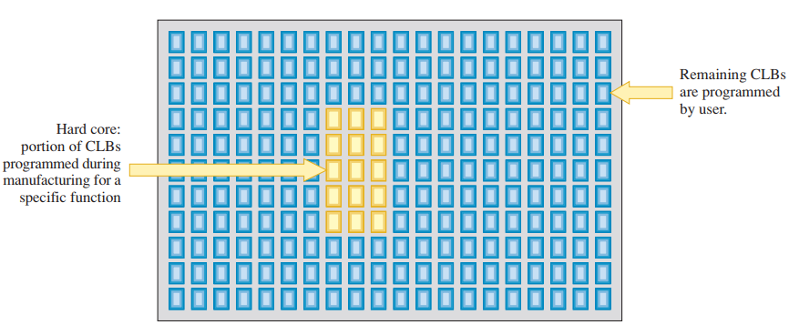
10.4. Field-Programmable Gate Arrays (FPGAs)
FPGA Cores In addition to programmable logic, an FPGA can also contain hard-core logic embedded by the manufacturer.

Slide 23
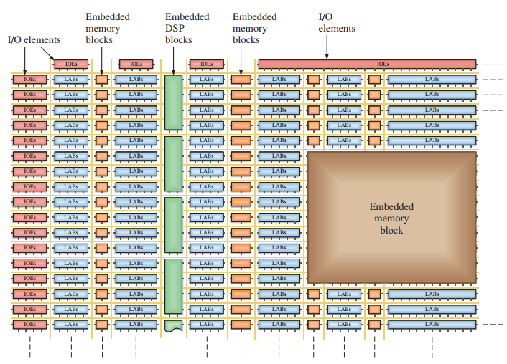
10.4. Field-Programmable Gate Arrays (FPGAs)
Embedded Functions FPGAs include embedded memory and DSP (Digital Signal Processing) functions.

Slide 24
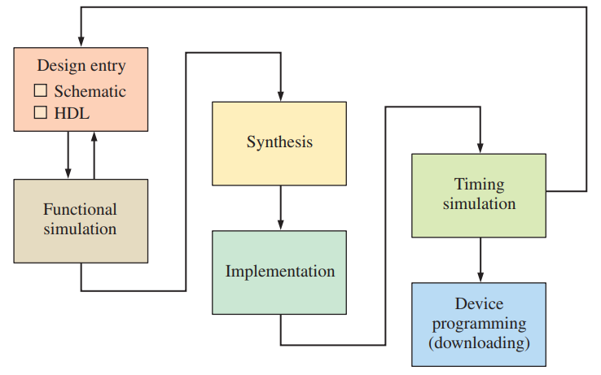
10.5. Programmable Logic Software
Design Flow in Programmable Logic

Slide 25
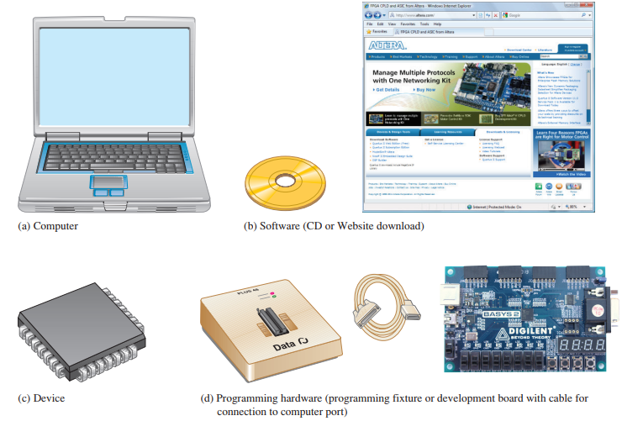

10.5. Programmable Logic Software
Getting Started with Programmable Logic Devices

Slide 26
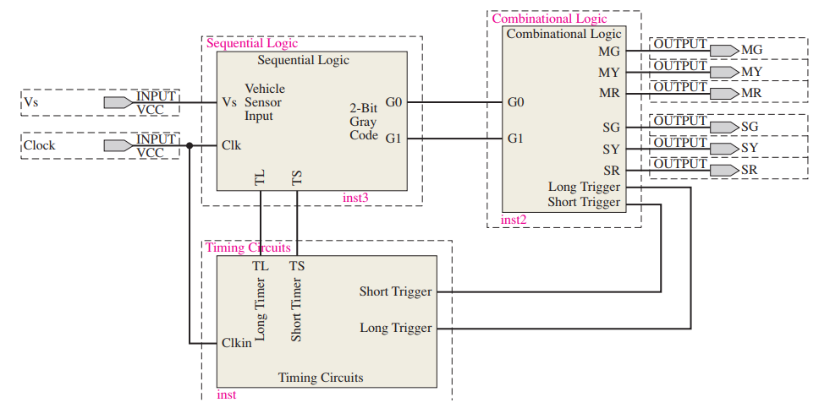
10.5. Programmable Logic Software
Design Entry & Logic Design in PLDs VHDL, Verilog, and schematic capture are all used in PLD development.

Slide 27

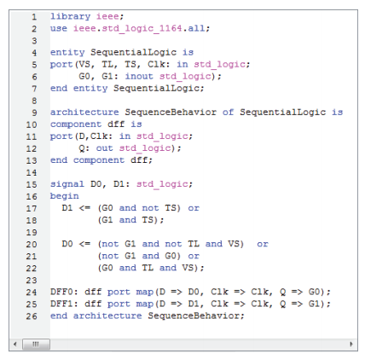
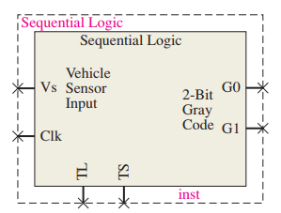
10.5. Programmable Logic Software
Programmable Logic

Slide 28
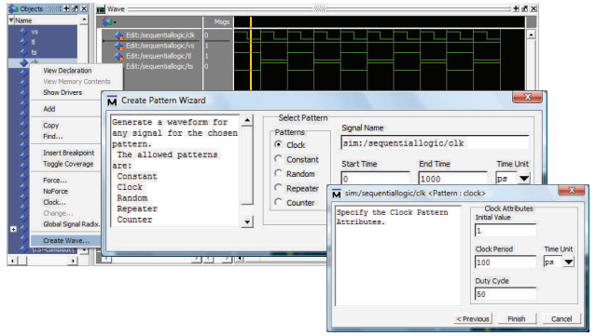

10.5. Programmable Logic Software
Functional Simulation

Slide 29
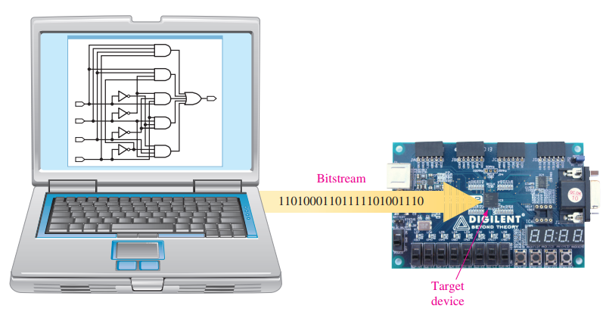
10.5. Programmable Logic Software
Device Programming (Downloading)

Slide 30
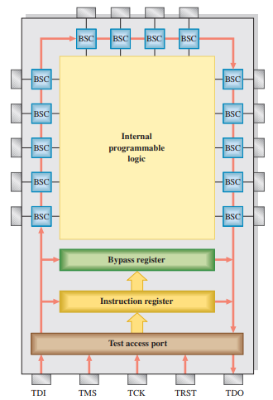
10.6. Boundary Scan Logic
IEEE Std. 1149.1 – Boundary Scan Registers & Instructions IEEE 1149.1 is commonly used for testing, verification, and debugging of digital hardware without requiring physical access.
Greatly simplified diagram of a JTAG-compliant (IEEE Std. 1149.1) programmable logic device (CPLD or FPGA). The BSCs (boundary scan cells) form the boundary scan register. Only a small number of BSCs are shown for illustration.

Slide 31
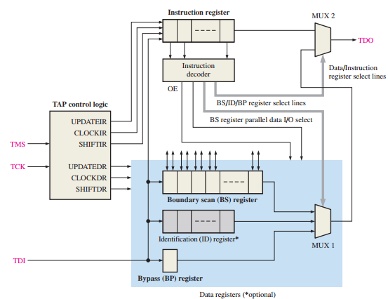
10.6. Boundary Scan Logic
IEEE 1149.1 TAP & Boundary Scan Logic The Test Access Port (TAP) consists of control logic, four mandatory inputs and outputs, and one defined optional input, Test Reset (TRST).
Test Access Port (TAP) – Main Components
TDI (Test Data In) – Receives test/programming data serially.
TDO (Test Data Out) – Outputs test data/instructions serially.
TMS (Test Mode Select) – Controls the state of the TAP controller.
TCK (Test Clock) – Provides clock signals to coordinate TAP operations.
TRST – Optional reset input)

Slide 32
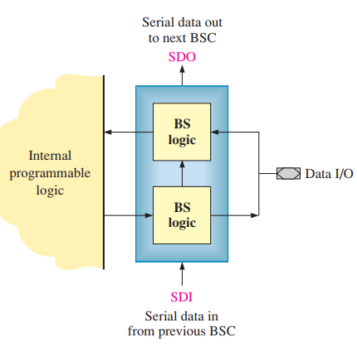
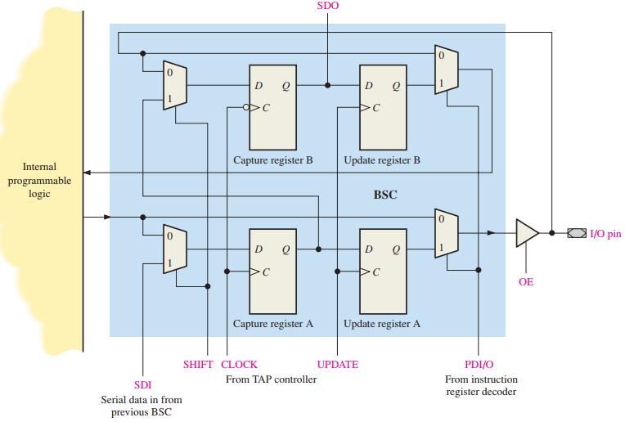

10.6. Boundary Scan Logic
The Boundary Scan Cell (BSC)

Slide 33
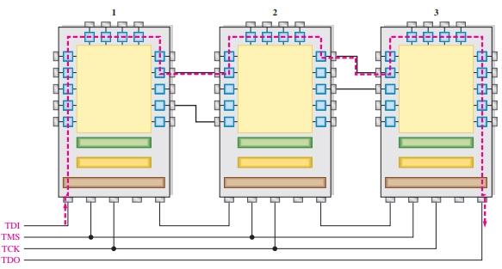
10.6. Boundary Scan Logic
Boundary Scan Testing of Multiple Devices Basic concept of boundary scan testing of multiple devices and interconnections. The test path is shown in red.

Slide 34
SUMMARY
Chapter 10: Programmable Logic
Types of Programmable Logic Devices:
SPLDs include PAL (programmed once) and GAL (reprogrammable).
CPLD is a complex logic device composed of multiple SPLDs with programmable interconnections.
FPGA has a different architecture using LUTs (Look-Up Tables) and CLBs (Configurable Logic Blocks).
2. Structure and Programmability:
Devices consist of logic blocks like LABs or CLBs, each containing macrocells.
Macrocells can operate in two modes: combinational or sequential, depending on the design.
3. Digital Logic Design Process:
Includes steps: design entry, functional simulation, synthesis, implementation, timing simulation, and programming the device.
This process is known as the design flow.
4. Testing and Verification

Slide 35
MULTIPLE-CHOICE TEST AND PROBLEMS
Complete the true/false questions, multiple-choice questions, and end-of-chapter exercises in the primary textbook.

